Slide 1

Scaling Emulation and Software Preservation Infrastructure
Dr. Klaus Rechert, OpenSLX GmbH
@kurau5u
http://emulation.solutions by

Slide 2
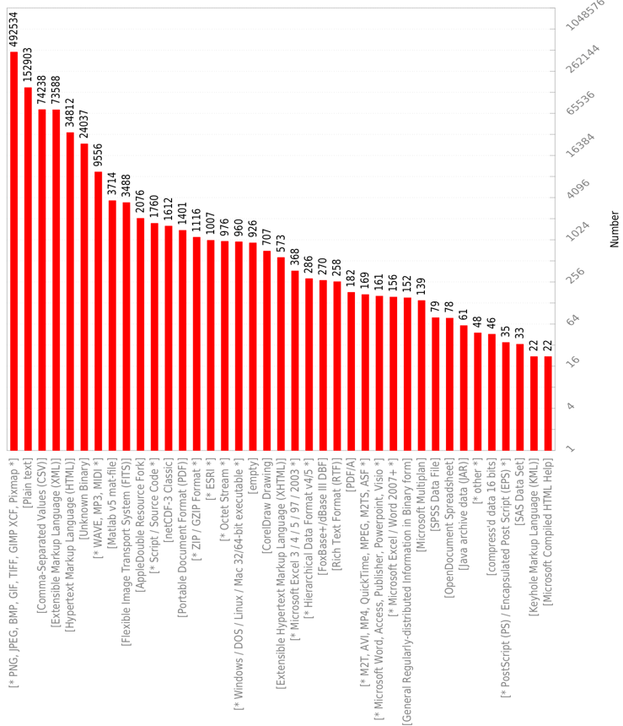
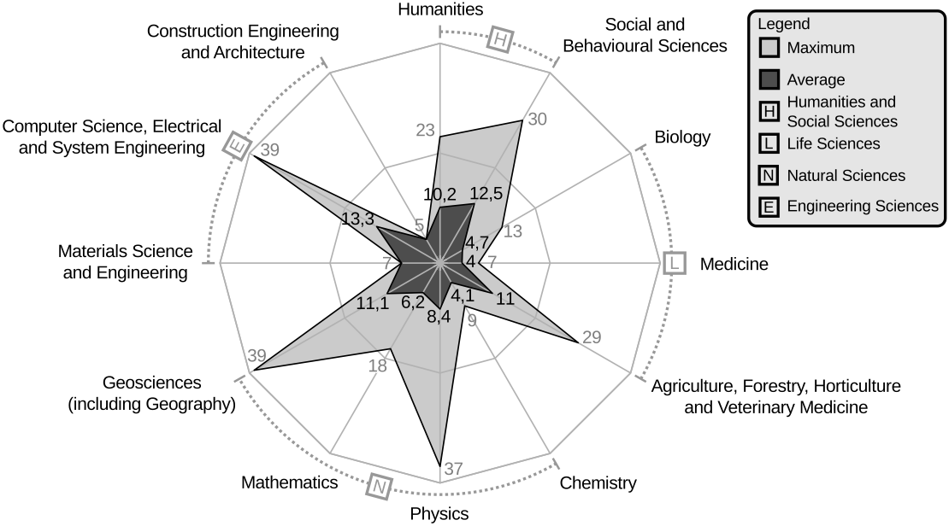
Random data sets from 92 public repositories (1,95 TB / 3.5 Mio. files):
At least 140 different file formats (lower boundary)
4 to 39 different file formats per dataset. E.g. humanities use an avg. of 10,2 formats / data set.
Are research data sets FAIR in the long run? Wehrle & Rechert, iDCC 2018
Notes:
We already have established practices to store and cite research data. The question though, how long is this data actually usable.
To get a better sense, we looked into some random data sets, and what you typically find are mixed bags.
For these you most likely need the appropriate software for reuse.

Slide 3
Software Preservation
Software Sustainability Institute
  Checklist for a Software Management Plan
    https://zenodo.org/record/2159713
  Software Deposit Guidance
    https://softwaresaved.github.io/software-deposit-guidance/
FORCE11
  Software Citation Principles
    https://www.force11.org/software-citation-principles
Software Heritage
  Source Code Archive
    https://archive.softwareheritage.org/

Slide 4
Software Preservation
Software Preservation Network
  Scaling Software Preservation and Emulation Infrastructure (EaaSI)
    https://www.softwarepreservationnetwork.org/eaasi/
  Fostering a Community of Practice: Preservation and Emulation in Library, Archives and Museums
    https://www.softwarepreservationnetwork.org/fcop/
  License and rights management
Internet Archive
UNESCO Persist
And many other smaller institutions and informal initiatives

Slide 5
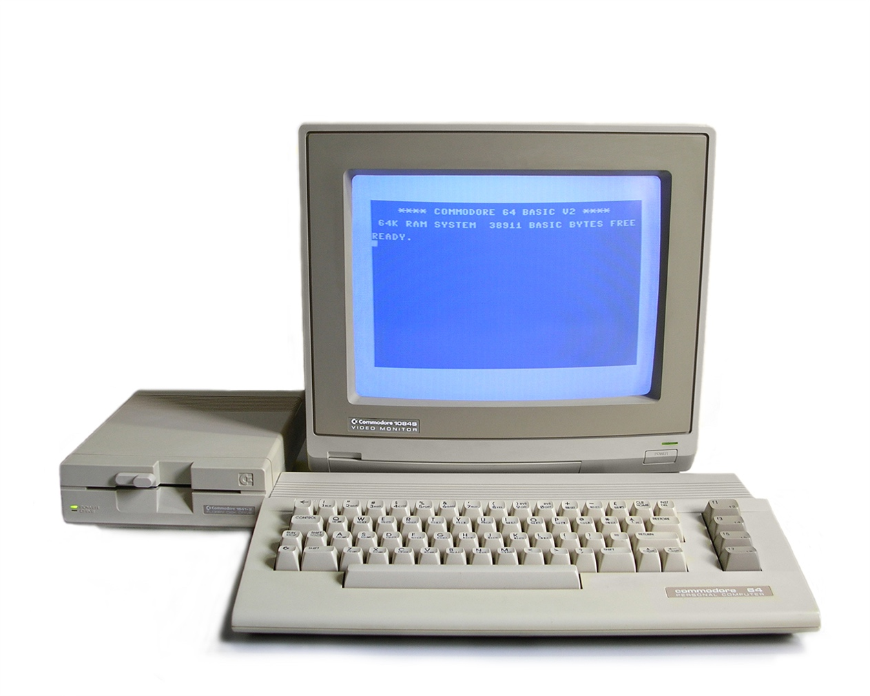
Emulation
Emulation as Access Strategy
  Idea: Implement a hardware equivalent in software
    CS: every hardware logic circuit has an equivalent representation in software
  Not a new idea (cf. Rothenberg, 1995)!
  However technically complex:
    Usability
    Scalability
    Preservation Paradox
Notes:
Skaliert: weder viele Nutzer noch viele Objekte

Slide 6
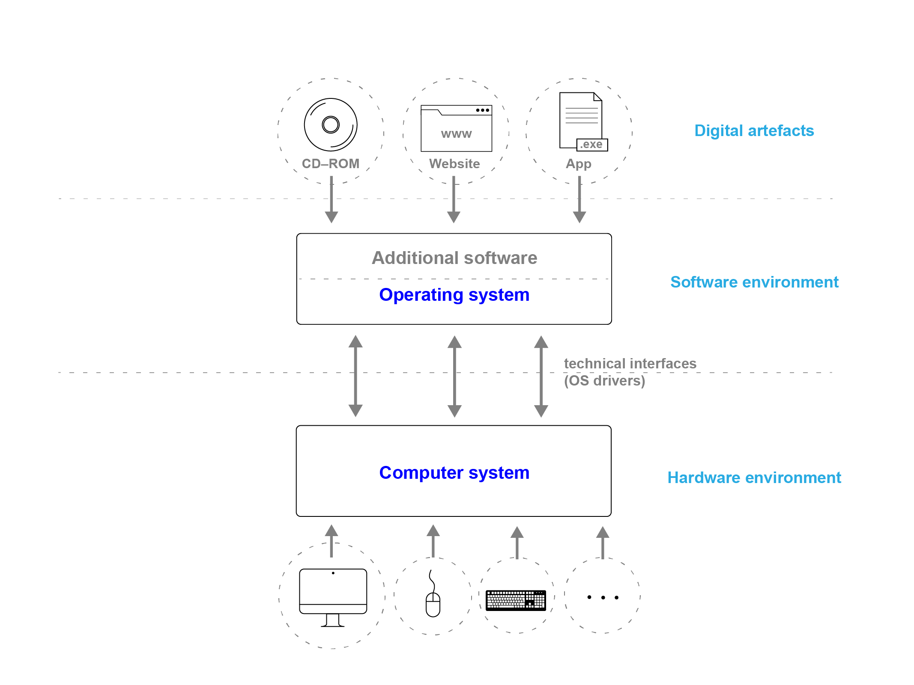
Dissecting a Digital Artefact
Notes:
If a task seems to be too complex, just divide it into layers.

Slide 7
Huge number of different dig. object types
Objects fixed. Archived objects do not change over time.
Notes:
Custom-built software: unique objects → individual preservation plans essentiall

Slide 8
Huge number of different dig. objects.
Fixed. Do usually not change over time.
Rather small number of different hardware environments.
Require replacements (continuously).

Slide 9
This is where the two worlds meet.
Notes:
This is where these two worlds meet. And this is the most interesting work field. division of laber, do what you do best
From the bottom, very technical, keep emulators working, make sure them exchangeable, if they break / become obsolte.
protect the work that has been done on the upper layers.
Goal is there anything that can be shared among objects/institutions?
identify boundaries between generic technical tasks and object specific tasks.
E.g. mainatining a collection of rather generic software environments, that can be used with multiple objects (and can be simply adopted for specific tasks).

Slide 10
Emulation as a Service
Store and maintain contents of all three layers separately
Combine theses three layers to a executable environment “on-demand”
Supplies right emulator version and preconfigures common settings
Enables access to emulators over the web via browser interface
Smooths creation of new emulated computing environments
Smooths configuration of common OS features in legacy systems
Notes:
this is the basic idea of emulation as a service:
To maintain this flexibility, combine the three layers just using metadata
Simplify the technology as possible, having well maintained emulators
Simpliffy access and emulation related workflows: e.g. create a software environment to render an object
---
Just to avoid confusion. we do not develop emulators, that would be a wast of time. Use what is out there, make them usable and accessible for preservation ans similar purposes.

Slide 11
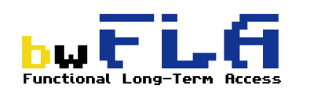



Emulation as a Service
In development by the bwFLA team at the University of Freiburg since 2011
Since 2016 EMiL – Reading Room Solution (German Nat. Library)
Since OpenSLX GmbH provides commercial support
Since 2017 CiTAR builds RDM workflows to repeat, replicate, reproduce or reuse software based research on top of EaaS
Since 2018 the EaaSI project

Slide 12
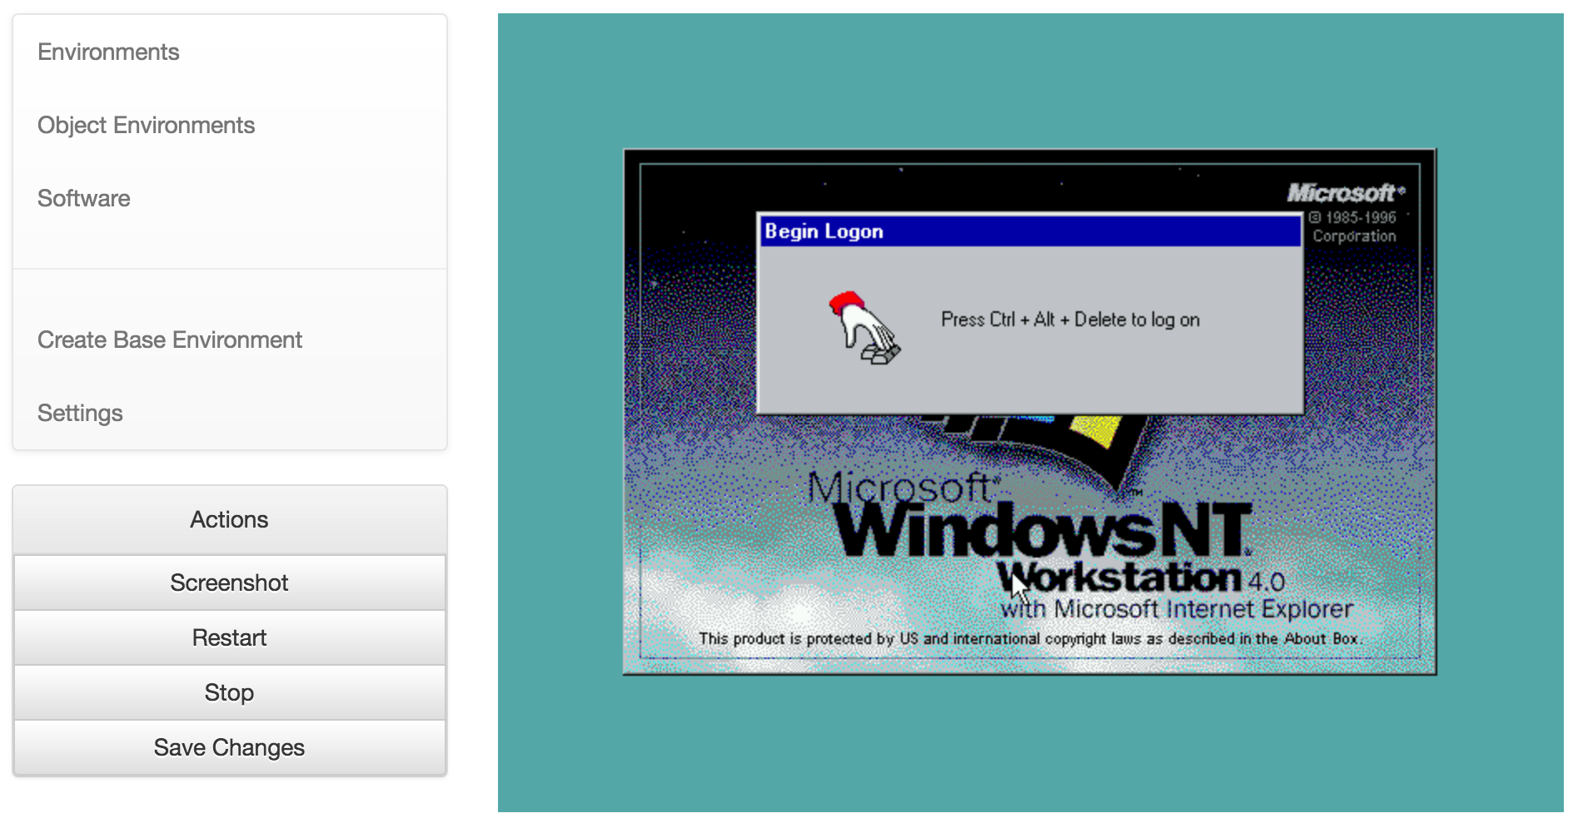
Emulation as a Service
Notes:
Two sides:
1. curation: create, manage and test environments
2. publication: provide access, reading room or cloud.

Slide 13
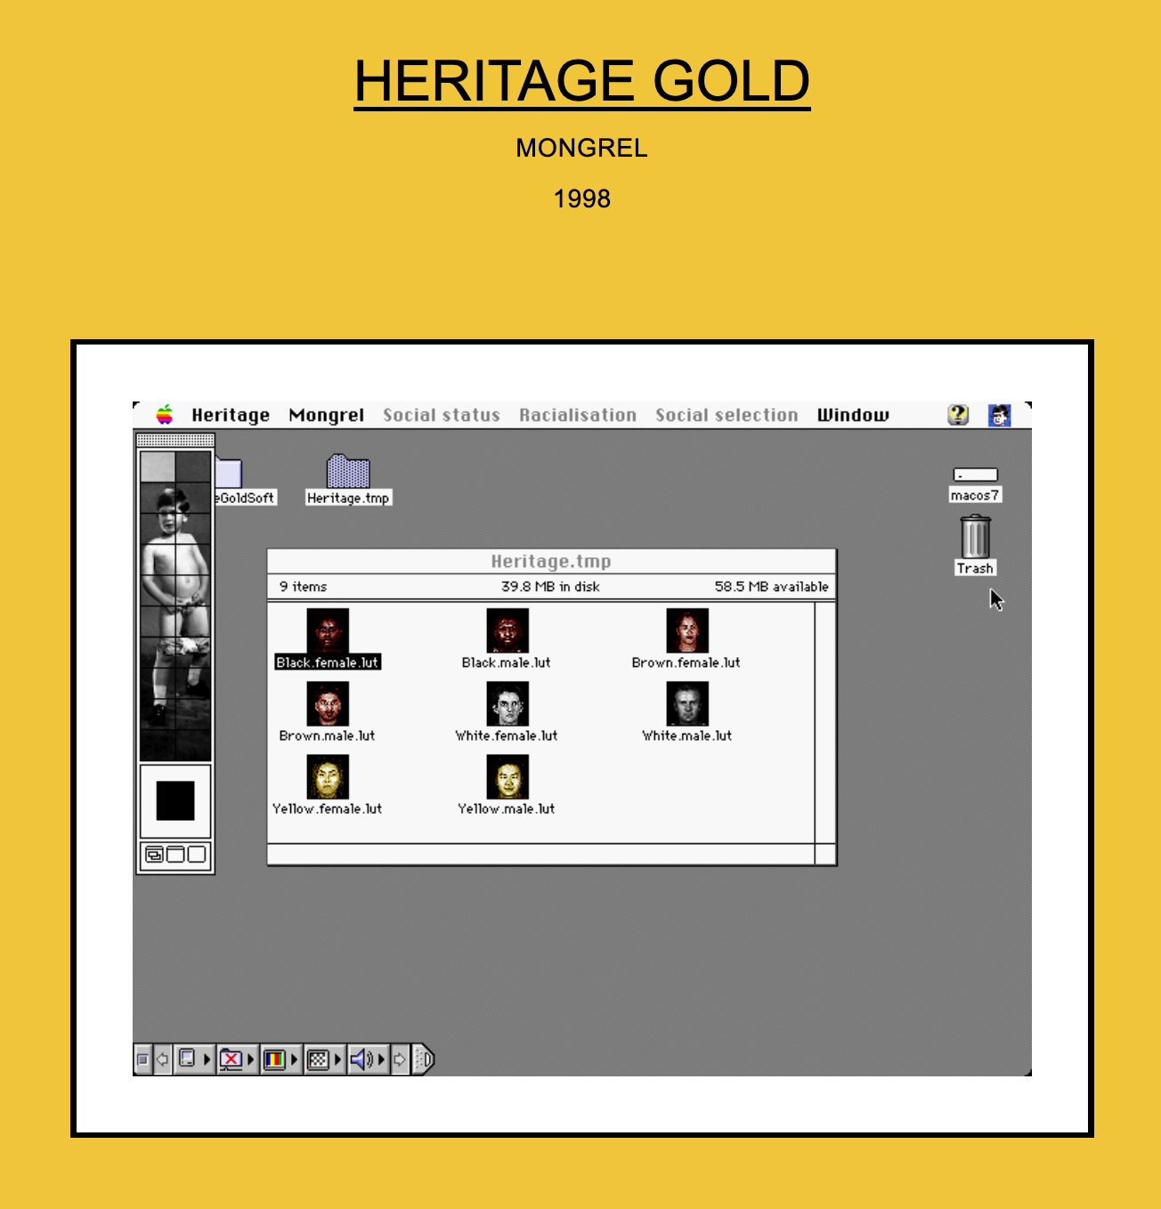
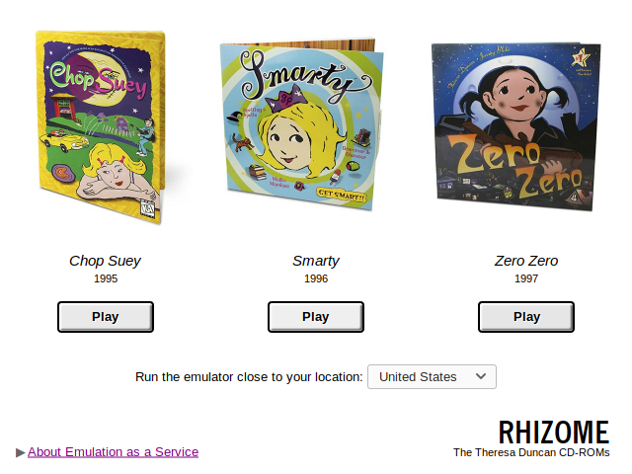
EaaS in Production
http://archive.rhizome.org/theresa-duncan-cdroms
http://archive.rhizome.org/anthology/heritage-gold.html

Slide 14

Notes:
The technology is there and works, but for a wider addoption more work needs to be done.

Slide 15


EaaSI: Scale Up
Streamline infrastructure for ease of deployment and operation
Enhance usability of interface and system workflows
Improve performance and security
Notes:
Firstly, EaaS needs to be improved
multi-user, UI/UX

Slide 16

Share Work & Expertise
Decentralized network of emulation nodes
Able to share software resources and emulation environments in the network
Thousands of pre-configured software environments and software resources provided by Yale University Library
Notes:
If you remember the slide with the layer. The middle layer (software environments) offers a lot of options for sharing work and expertise
we create a network of EaaSI node hosts, where every node can contribute and can benefit from expertise from others. Have you ever installed AutoCAD for DOS? We don‘t have to repeat this exercise every time

Slide 17

Discovery & Description
Defining profile for description of software and computer environments
Comprehensive, open, machine-readable documentation
Incorporating services developed by Wikidata for Digital Preservation
Notes:
Another problem is the lack of machine-actional metadata about software and their capabilities.
Usually a search request starts with an object, so we need to know which software is able to render it.

Slide 18

Access
Emulated CD-ROM environment sharing service
Virtual Reading Rooms Service
Scientific Software Portal
API to automatically render objects in original software via emulation
Notes:
There will be four products

Slide 19
Our Team

Slide 20


Euan Cochrane (YUL) Principal Investigator
Seth Anderson (YUL) Program Manager
Ethan Gates (YUL) Software Preservation Analyst
Klaus Rechert & Oleg Stobbe (OpenSLX) Technical Architecture and Development
Jessica Meyerson (Educopia/SPN) Communications/Outreach
Kat Thornton (Data Current/WikiDP) Semantic Architect
Justin Aubin, Mac Schmidt, Zoe Sinclair, Idris Sylvester, Eric Timperman, Matt Tu, Kohei Yamaguchi
Software Emulation Configuration Workers

Slide 21
Our Node Hosts
Stanford University
Carnegie Mellon University
Yale University
University of California - San Diego
Notre Dame University
University of Virginia

Slide 22


A Very Special Thanks to our Funders...

Slide 23
Thank you!
klaus@openslx.com (@kurau5u)
http://www.softwarepreservationnetwork.org/eaasi
http://emulation.solutions by

